Slide 1
ALL ABOUT PLANTS

Slide 2
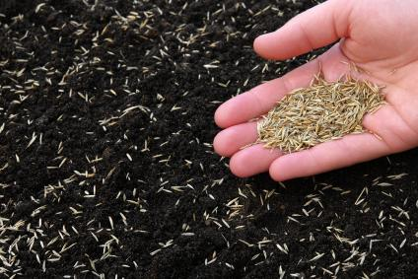
PARTS OF A SEED
Seeds develop into plants which we use for food
Seeds need WATER, AIR and WARMTH to grow
They also need all their parts to grow
Seed Coat: This is on the OUTSIDE of the seed. It protects the seed from harm
Embryo: This is the part which will grow into the plant. It has a small leaf and root for when the plant starts to grow
Endosperm: This contains the FOOD needed for the seed to grow

Slide 3
PARTS OF A PLANT
Pants have many parts which are all needed for the plant to grow and make food
Flower: The flower is usually very colourful which helps attract pollinators (ex: bees) to the plant
Leaf: Comes in many different shapes and sizes. It takes in sunlight and carbon dioxide from the air and transforms it into food for the plant
Stem: The stem helps the plant stand up straight. It also transports food and water to all the other parts of the plant
Seeds: This has baby plants in them
Roots: The roots are underground. They help anchor the plant so that it doesn’t move. It also takes in water and nutrients from the soil to help the plant to grow
Flower
Leaf
Stem
Roots

Slide 4
WATER CYCLE
The water cycle is very important as it helps the plants we eat to grow
PRECIPITATION is when it rains or snows
When it rains (or snows) the water goes into nearby water sources (i.e. river, lake, sea) where it is COLLECTED
The sun EVAPORATES this water
The water rises into the sky as moisture droplets
This moisture CONDENDSES in clouds until the cloud becomes too full and it rains
The cycle starts over again

Slide 6
PHOTOSYNTHESIS
Plants make their own food through a process called PHOTOSYNTHESIS
Plants take in CARBON DIOXIDE from the air
SUNLIGHT provides the plant with energy
The plant uses it’s roots to intake WATER
Water, carbon dioxide and energy is converted in the plant
The plant produces OXYGEN which is released into the air
It also produces SUGAR which helps the plant to grow

